Slide 1

Presentasi Week 2 Bootcamp DevOps Dumbways
Asep Saepul Rohman

Slide 2
Manage Code dan Database
Install Git and SSH Key
Setup Database
Deployment Backend Application

Slide 3
Git
Fork repository public backend https://github.com/sgnd/wayshub-backend.git
Membuat repository private backend di Github

Slide 4
Git
git clone --bare https://github.com/sgnd/wayshub-backend.git
Cd wayshub-backend.git
git push --mirror https://github.com/asepboy/wayshubBackend.git
git clone https://github.com/asepboy/wayshubBackend.git

Slide 5
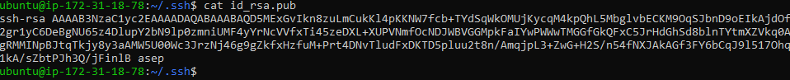
Login Git via SSH
Cat id_rsa.pub
Cat id_rsa.pub
ssh-keygen -C “asep”
cd .ssh/
Cat id_rsa.pub

Slide 6
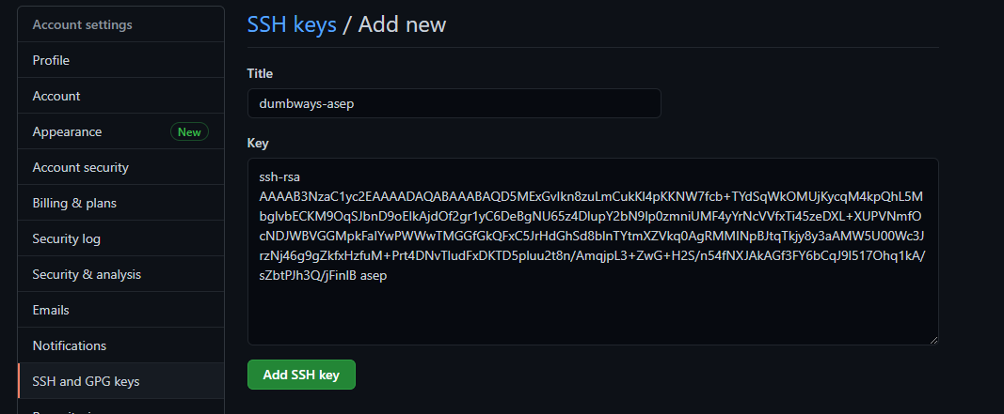
Login Git via SSH
Kembali ke website Github
Settings > SSH and GPG Keys > New SSH key

Slide 7
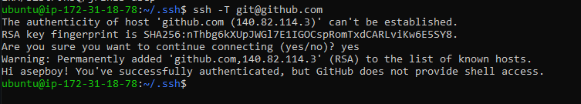
Login Git via SSH
ssh -T git@github.com
cd /wayshubBackend
git remote rm origin
git remote add origin
git remote -v

Slide 8
Database
Membuat instance database
Instal MySQL Server di instance database dan MySQL Client di instance backend
Menambahkan User database di instance database yang akan diremote dari instance backend dengan akses penuh
Remote database via server backend

Slide 9
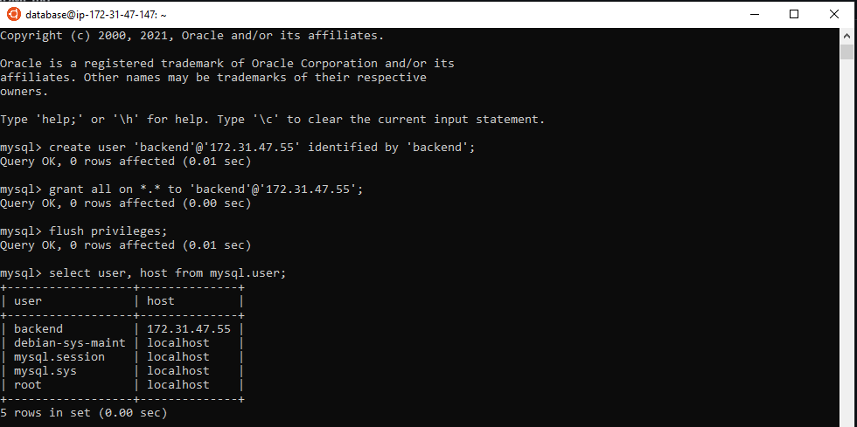
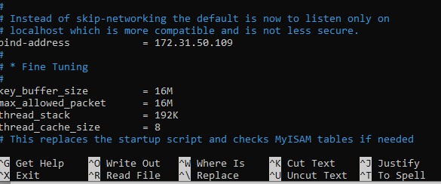
Database
Instal MySQL Server di instance database
Membuat user untuk bisa diremote dari instance backend
Mengubah bind-address dengan ip instance database di directory /etc/mysql/mysql.conf.d

Slide 10
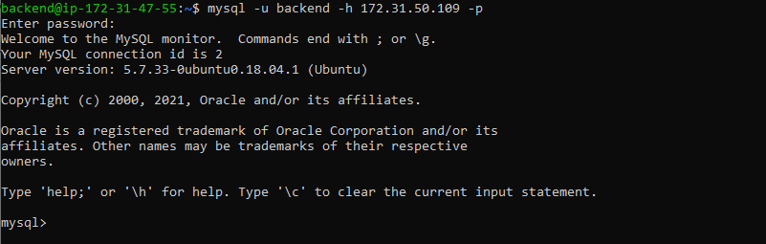
Database
Instal MySQL Client di instance Backend
Remote database server di instance backend

Slide 11
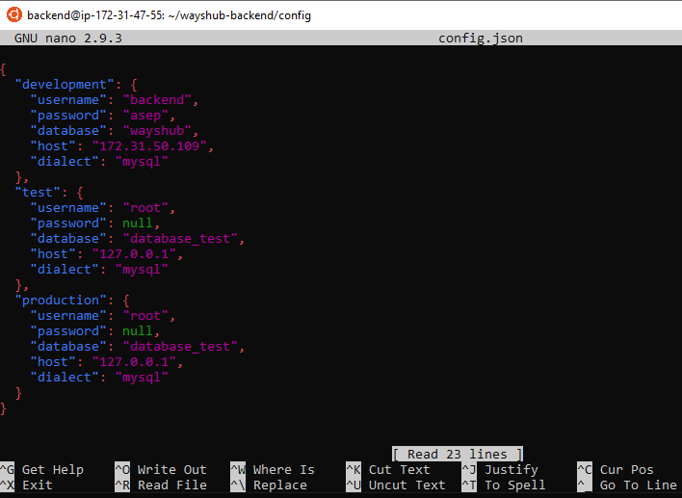
Deployment Backend Application
Login git via SSH
Instal nodejs, npm, pm2, dan sequelize
Nano /library-backend1/config/config.json

Slide 12
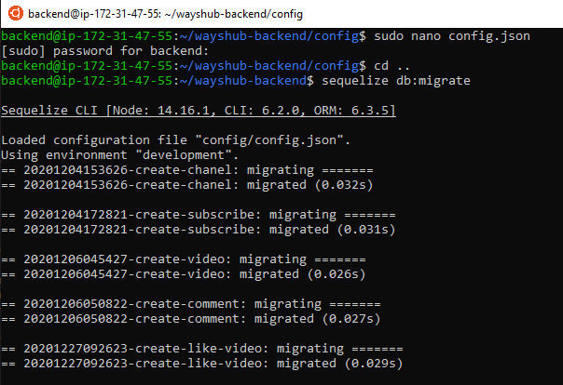
Deployment Backend Application
Migrasi database
Jalankan service pm2 dengan perintah
pm2 --name Wayhub-backend start npm -- start

Slide 13
Terima Kasih

